Slide 1
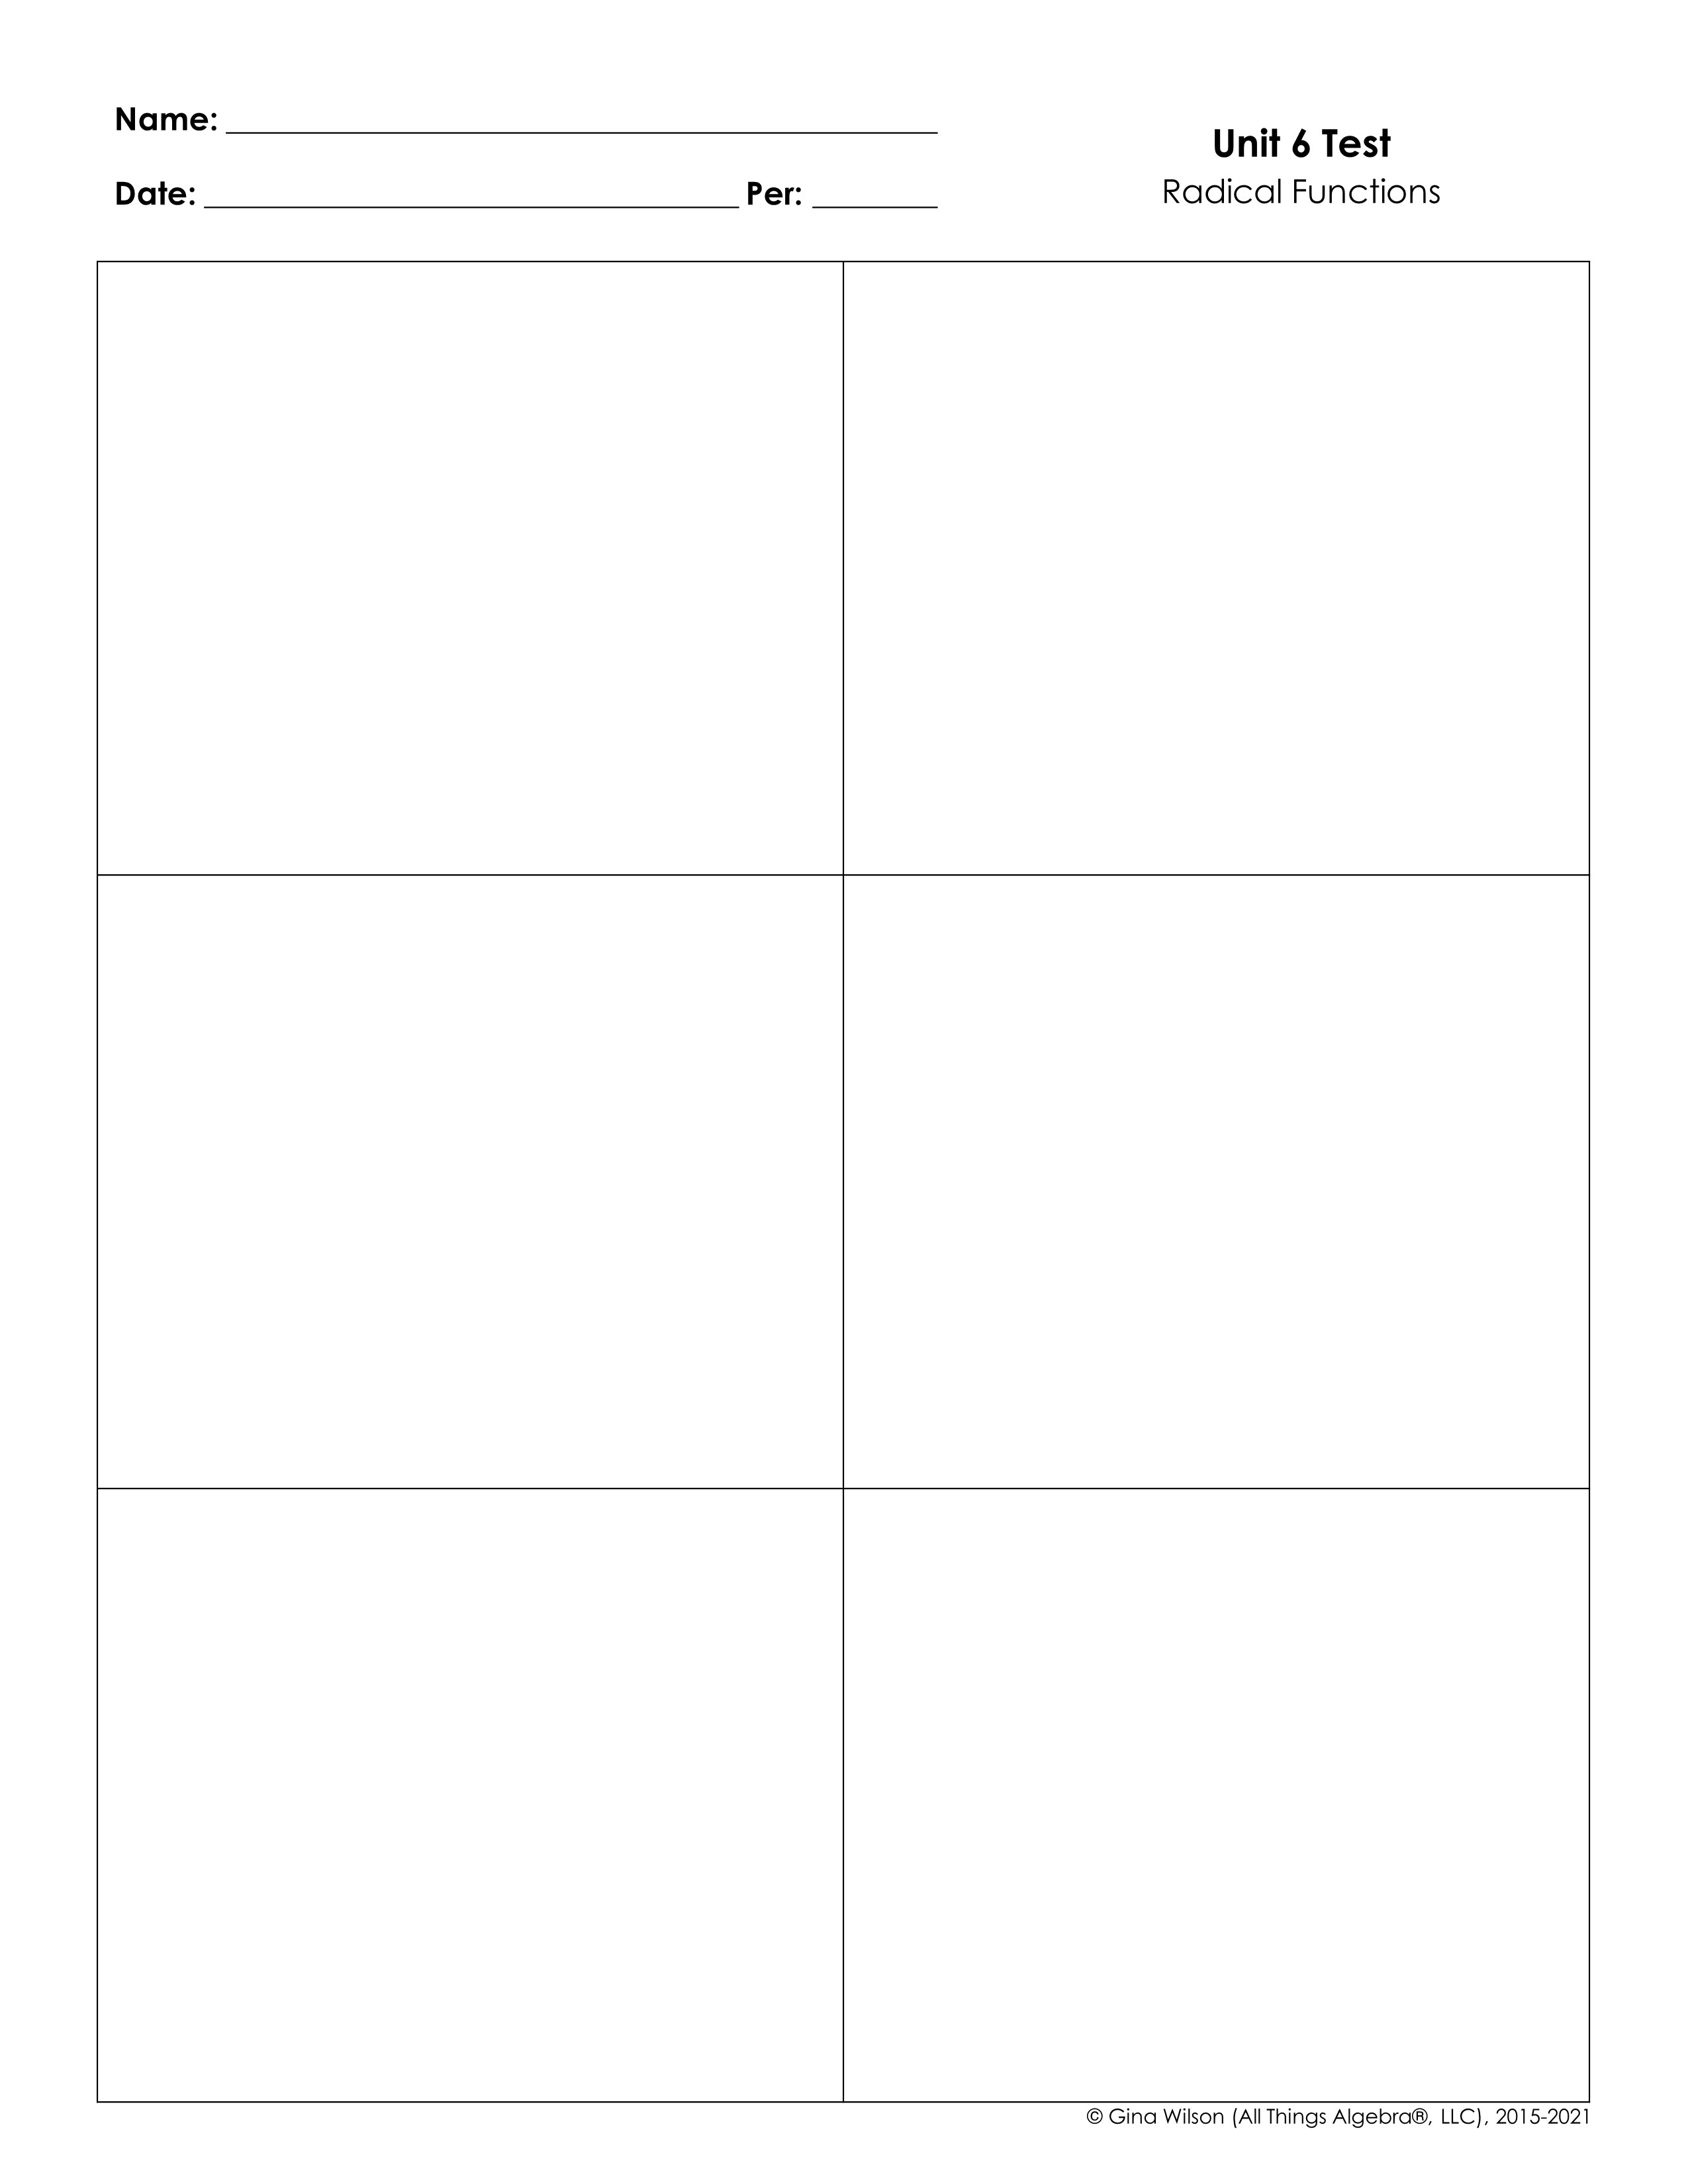
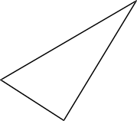
1. Simplify the expression below.
2. Simplify the expression below.
A. B. C. D.
A. B. C. D.
3. Find the perimeter of the triangle below. Write your answer in simplest radical form.
4. Simplify the expression below.
A. B. C. D.
5. Simplify the expression below.
6. Simplify the expression below.

Slide 2

7. Simplify the expression below.
8. The side length of a square is meters. Find the area of the square and write your answer in simplest radical form.
9. Simplify the expression below.
10. Simplify the expression below.
A. B. C. D.
A. C. B. D.
11. Simplify the expression below.
12. Simplify the expression below.
A. C. B. D.
13. Simplify the expression below.
14. Simplify the expression below.

Slide 3

15. Which is equivalent to the expression below?
16. Which is equivalent to the expression below?
A. B.
C. D.
A. B.
C. D.
17. Simplify the expression below.
18. Simplify the expression below.
A. B. C. D.
19. Simplify the expression below.
20. Simplify the expression below.
A. B. C. D.
21. Solve the equation below.
22. Solve the equation below.

Slide 4

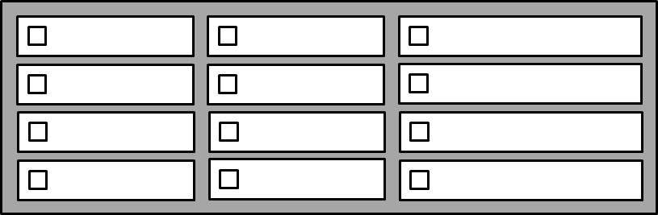
23. Solve the equation below.
24. Solve the equation below.
25. Solve the equation below.
26. Solve the equation below.
27. The square root parent function is translated so that the endpoint is located at (-7, 1). Write an equation that represents this new function.
28. What transformations take place by graphing the function below in respect to its parent function? Check all that apply.
Up 9 units
Up 4 units
Vertical Stretch
Down 9 units
Down 4 units
Vertical Compression
Left 9 units
Left 4 units
Reflection in x-axis
Right 9 units
Right 4 units
Reflection in y-axis

Slide 5

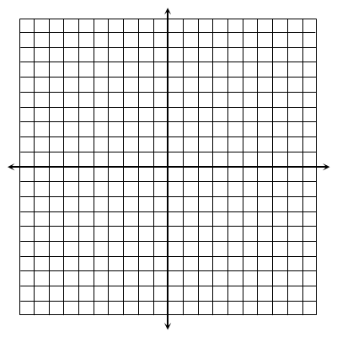
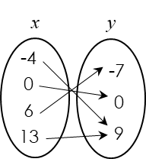
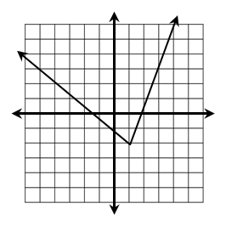
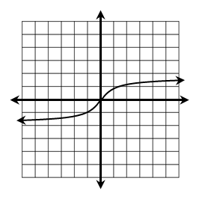
Graph each function and identify its key characteristics.
29.
D: _________________ R: ________________
Endpoint: ______________ End Behavior: As ______, ______ As ______, ______
Increasing Interval(s): _______________ _ Decreasing Interval(s): ______________
30.
D: _________________ R: ________________
Point of Inflection: ______________ End Behavior: As ______, ______ As ______, ______
Increasing Interval(s): _______________ _ Decreasing Interval(s): ______________
31.
D: _________________ R: ________________
Endpoint: ______________ End Behavior: As ______, ______ As ______, ______
Increasing Interval(s): _______________ _ Decreasing Interval(s): ______________
32. Which of the following relations represent a one-to-one function? Check all that apply.
x | y
-2 | -10
-1 | -5
1 | 5
2 | 10

Slide 6

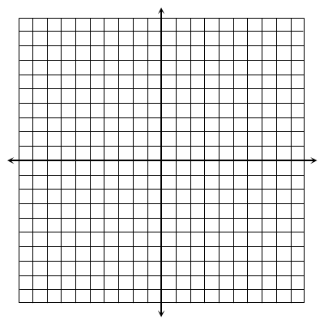

33. Write the inverse of the function below. Graph both functions to verify the relationship.
Inverse Function:
Determine whether the functions below are inverse functions. Prove your answer algebraically.
34.
and
Yes
No
35.
and
Yes
No
BONUS: Solve the equation:

